Slide 1
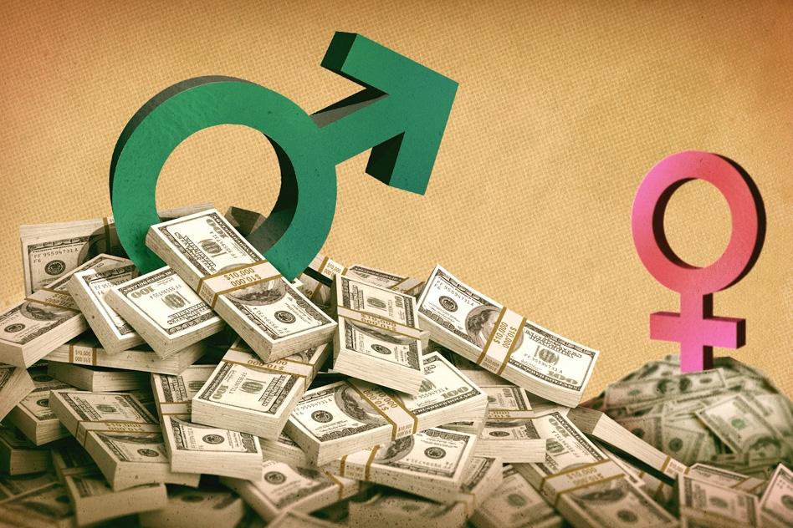
UK Gender Pay Gap
Data Analytics SQL Lab
Princesa Cloutier

Slide 2
Overview
Data combined from company self-reporting
Combined “Full-pay relevant employees” and “Relevant employees”
Relevant employees – Part-time, contractors, employees on leave, etc.
Full-pay relevant employees – Standard, full-time employees
Employee calculations – Positive or Negative
Positive – Skewed towards male employees
Negative – Skewed towards female employees
Zero – Assumed as no skew
“Relevant employees” only calculated for bonuses
Notes:
The dataset combined self-reported figures from the 10,174 companies listed in the report
Instructions on the gov.uk website informed companies how to compile their numbers and collect data
- Calculated averages resulted in either positive or negative percentages. Positive percentages meant that the pay skewed towards male employees. On the website, for example, if the employee calculated 13.59%, then that meant that male employees on average earned 13.59% more than their female employees, so for every £1 earned by a male employee, a female employee would earn 86p.
- Null values throughout the dataset were represented as 0. In the calculated rows, however, there were values showing 0 and 0.0. Because the calculated percentages were up to two decimal places and it was possible for companies not to have biases, I assumed values of 0.0 to be accurate and of just 0 to be Null. The latter were ignored during my observations
- Lastly, most of the data relied only on “full-pay relevant employees”, aka regular, full time employees, while all employees were considered with respect to bonus pay. This may have impacted some of the numbers.
- To understand the data, I looked at the median calculated values as opposed to the mean calculated values, because the median would be a more accurate representation of the average worker, who will be the one to deal with the consequences of positive or negative gender bias, as opposed to outliers that would skew our understanding of the data, for example large salaries from C-suite employees.

Slide 3
Geographical Differences
National average pay gap – 12.82
London average – 14.2
Major cities closer to national average
Notes:
The national average pay gap was found to be 12.82 – meaning that on average, male employees earn 12.82% more than their female counterparts
The country’s major cities were relatively close to the national average, though Glasgow was quite a bit lower than the others.
London has the highest rate at 14.20. However, if we consider the city’s financial district (London City Square Mile) the rate jumps up to 17.42, while the rest of the city is more like other cities in the country at a rate of 11.17.

Slide 4
Industry Impact - Finance
Companies in the financial sector had a gap rate of 30.82
Male-Female employee representation changes by over 10% per quartile
Significantly more female employees the lower the pay quartile
Notes:
Looking at the financial sector, we found that the pay gap averaged out to 30.82
If we look at all the listed companies within the industry, the average number of female and male employees changes dramatically across the pay levels. In the lower quartile, women account for about 60% of the employees and men 40%. With each successive quartile, the representation of male employees goes up by over 10% and drops by the same rate for female employees.
This is likely why there is such a large pay gap.

Slide 5
A Curious Comparison - Education
Companies in Education had a pay gap of 24.98
Overwhelmingly female sector
Male representation doubles from lower to top quartiles
Notes:
Interestingly, companies in the education-related industries had a pay gap of 24.98.
The numbers still skew towards male employees, yet the industry as a whole is overwhelmingly female, despite the near doubling of male representation between lower and top pay-quartiles

Slide 6
Reflections
More data could help explain unexpected results in pay gaps
Possible reasons:
Sum of male salaries is large enough to offset data even when a minority
Non-full-time staff might be skewing the numbers more
Would be interesting to see a geographical breakdown of male and female skews in pay.
Does it change the farther one is from major metropolitan areas?
Does it change the closer one is to progressive or conservative areas?
Does it change relative to local demographics?
Notes:
It would be interesting to get more data on the individual quartiles within an industry to see where this discrepancy lies. With the example of the education industries, It could be that where there are male employees there’s more money being paid to them and it skews the data even when they represent only a third of a quartile. It could also be that these numbers are offset by data contributions from part-time, contract, and on-leave employees (higher numbers of female employees would lend itself to higher numbers of employees on maternity leave, for example).

